Slide 1
IDForWeb User Testing Instructions (Mobile App)
Georgia Tech Institute of Information Security and Privacy
GT-IISP

Slide 2
Mobile-app Prerequisites
Android Device
Android version over 4.4 (Kitkat)
Check it at Settings – About Phone – Android version
Works for 4.4, 5.0 and up, and 6.0 and up.
Make sure the device is equipped with a front-facing camera
If you don’t have such devices, please use web-app at
https://idforweb.github.io

Slide 3
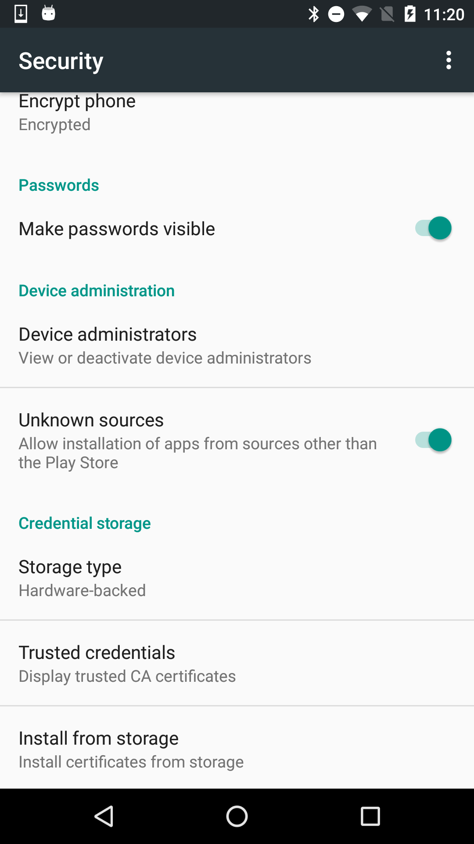
Mobile-app Prerequisites
Installation
On installing the app, you should allow unsigned application.
Go to Settings, Security, and touch to enable ‘Unknown Sources’

Slide 4
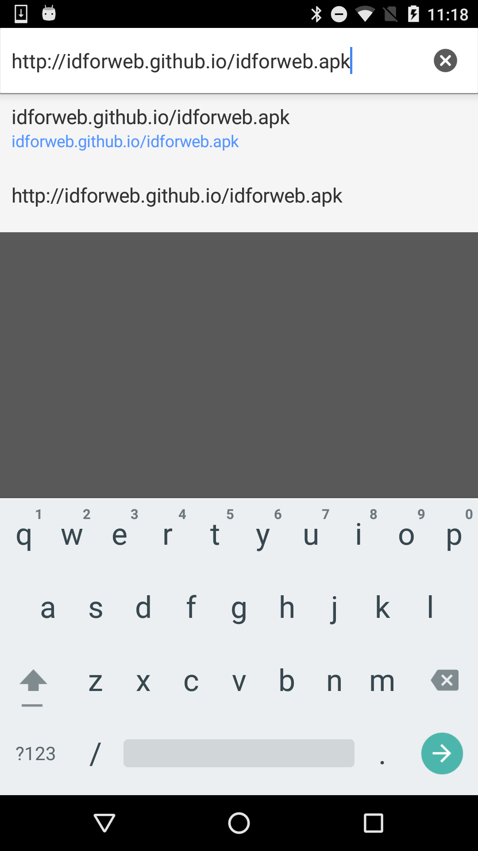
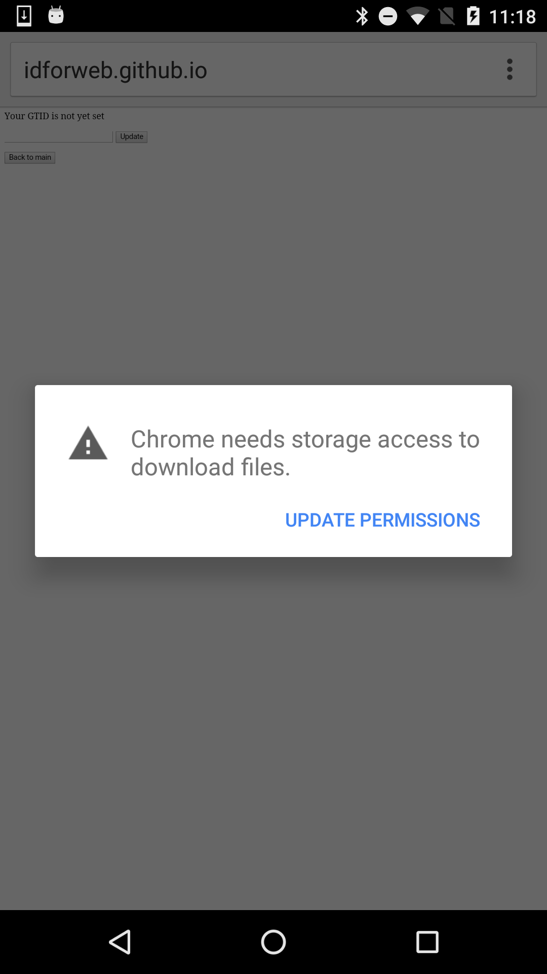
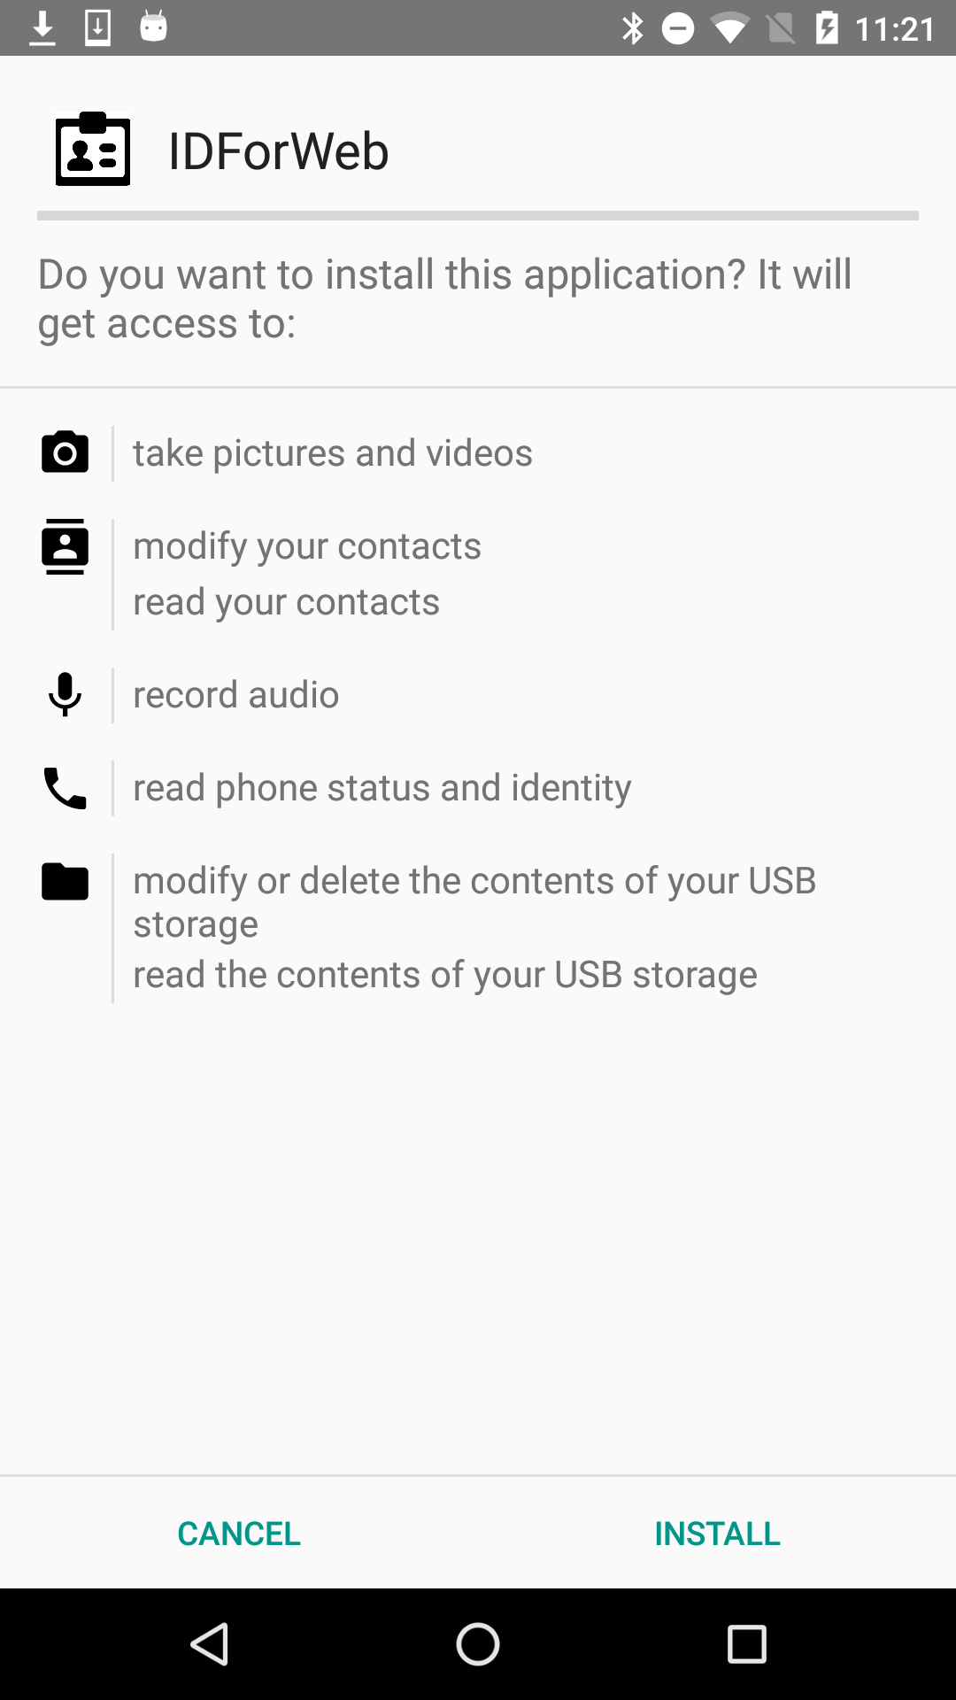
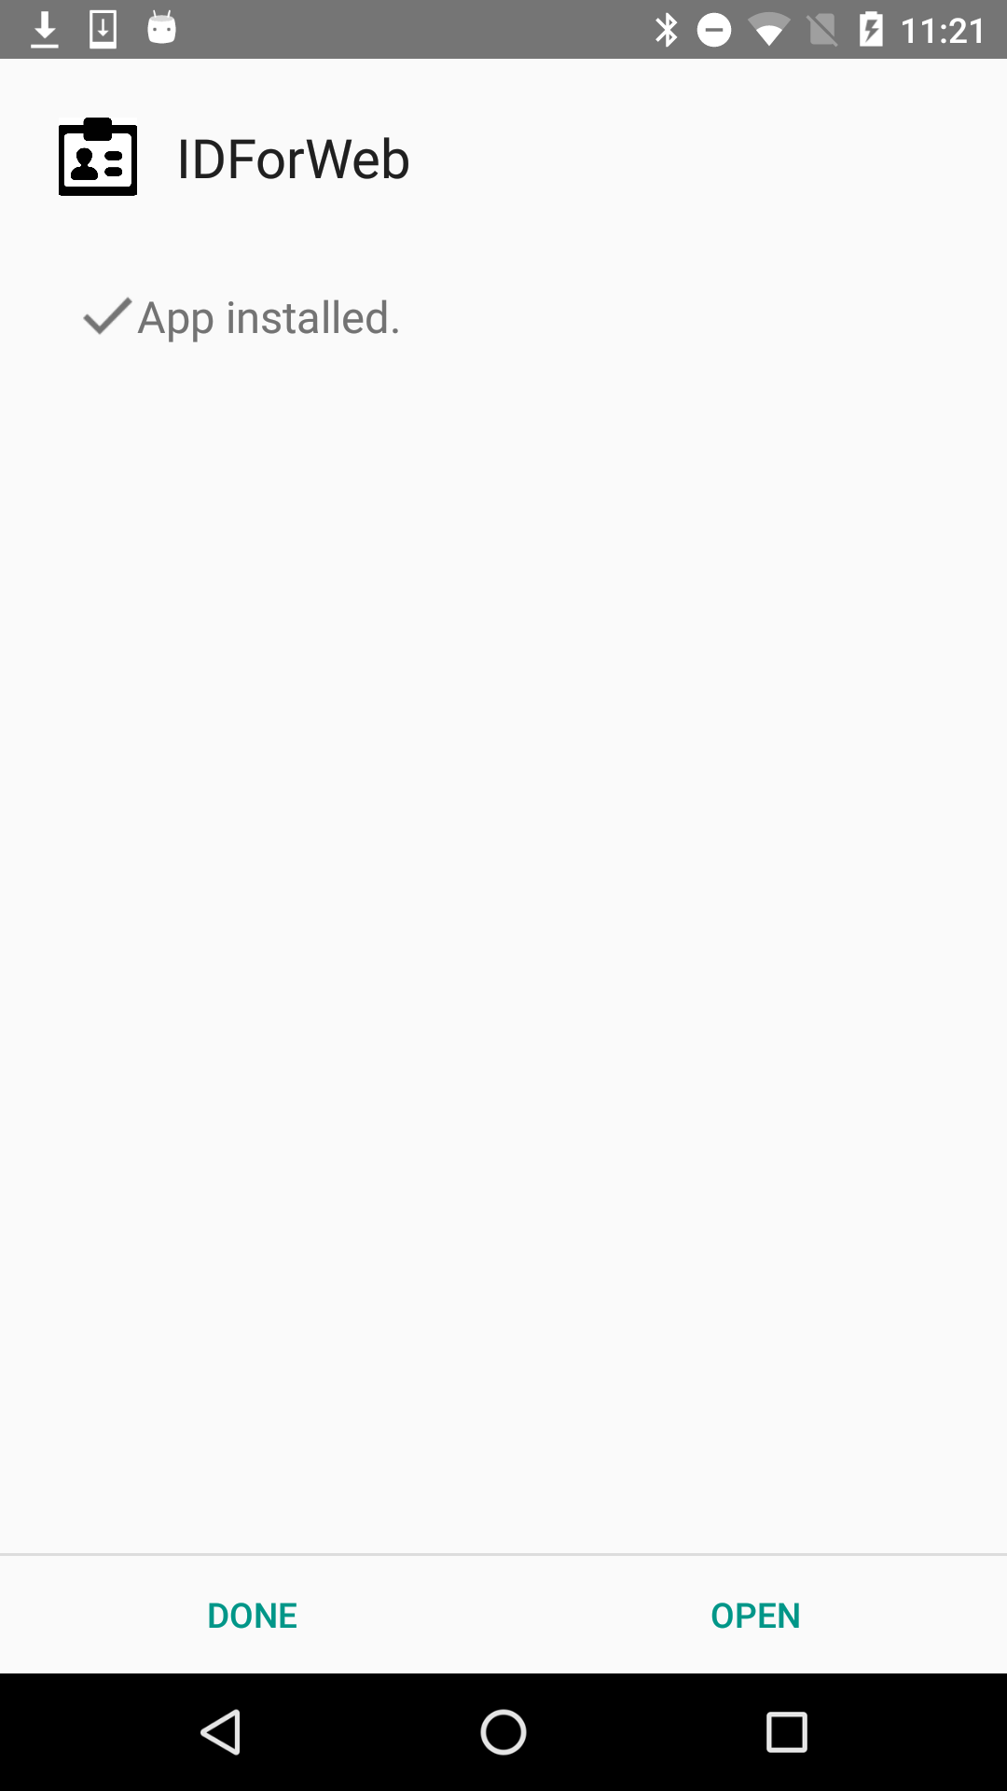
Mobile-app Prerequisites
Installation
Go to https://idforweb.github.io/idforweb.apk
Allow Chrome to have download access, then install the app.

Slide 5
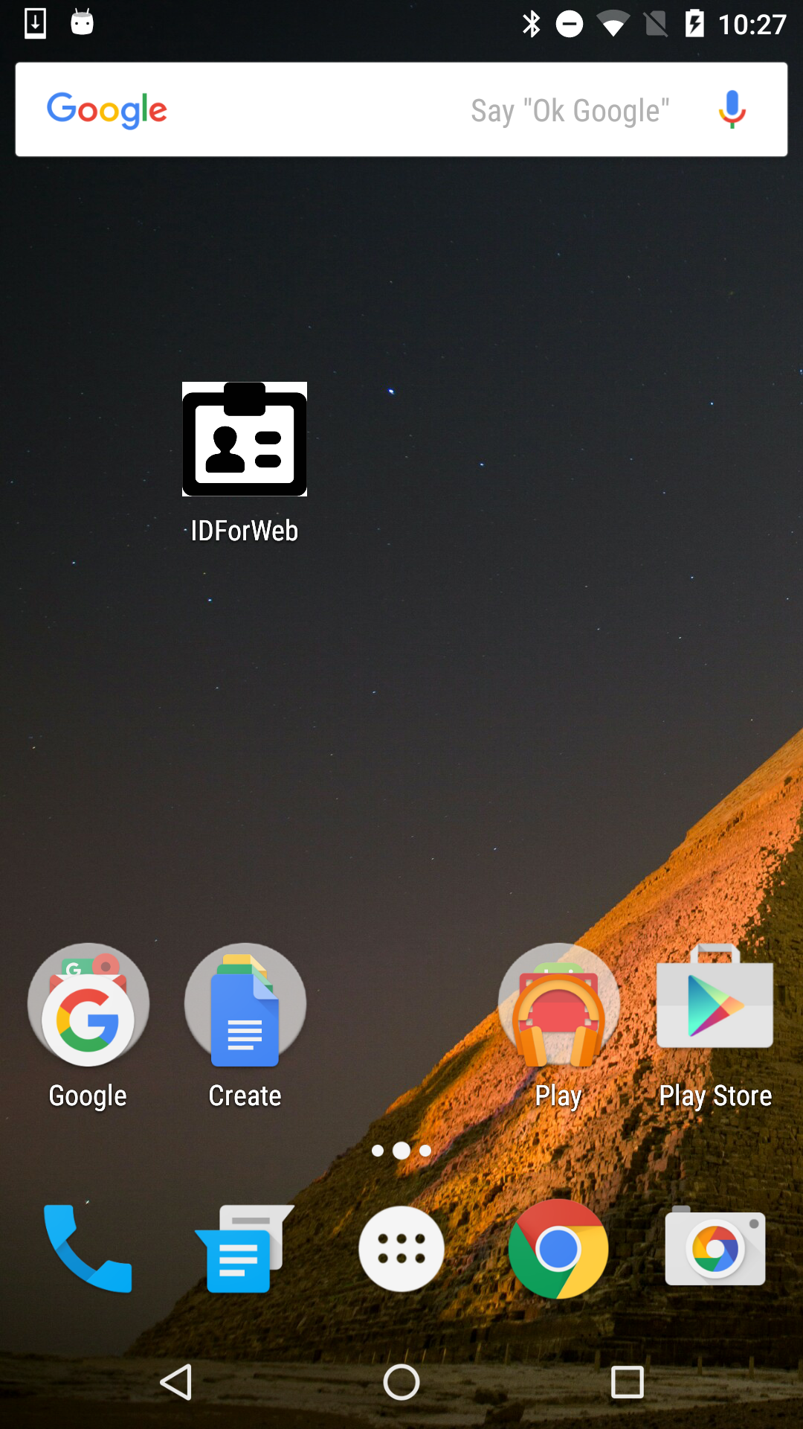
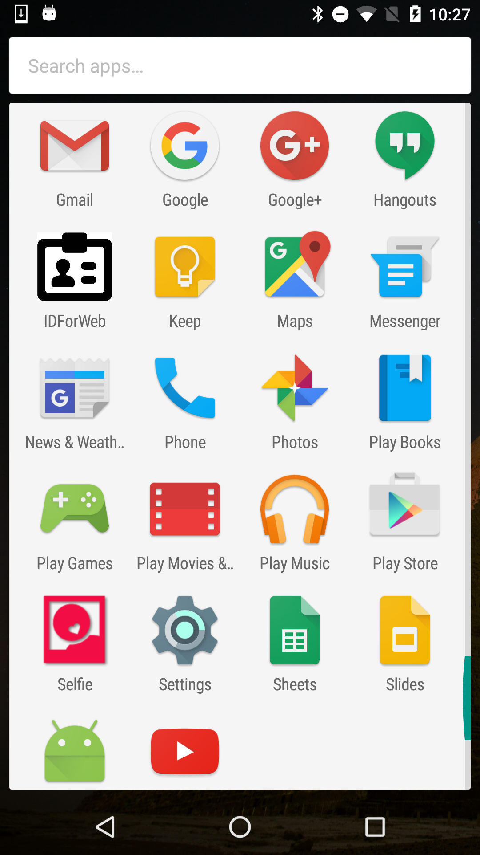
Mobile-app Prerequisites
Launching
Find the app named ‘IDForWeb’, and click to launch
It can either be on the main screen or in the launcher

Slide 6
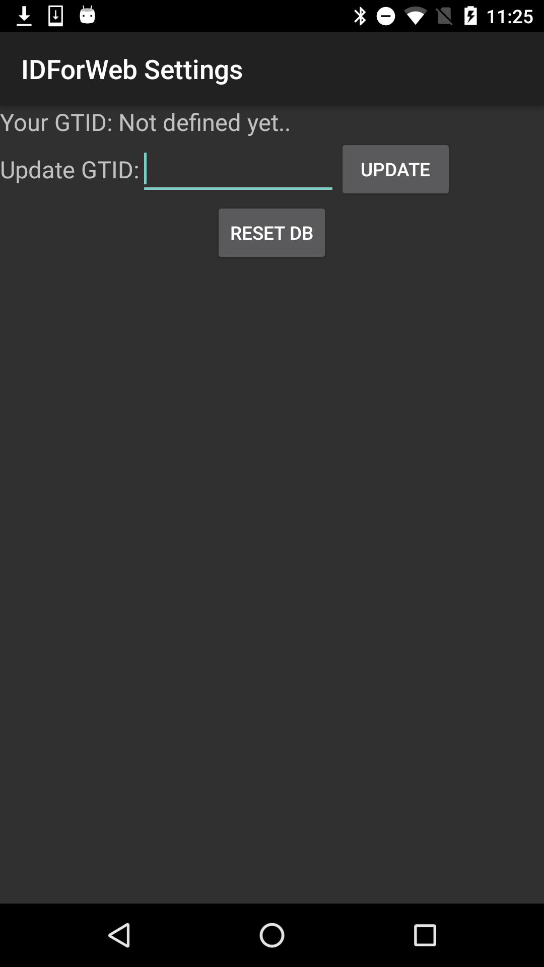
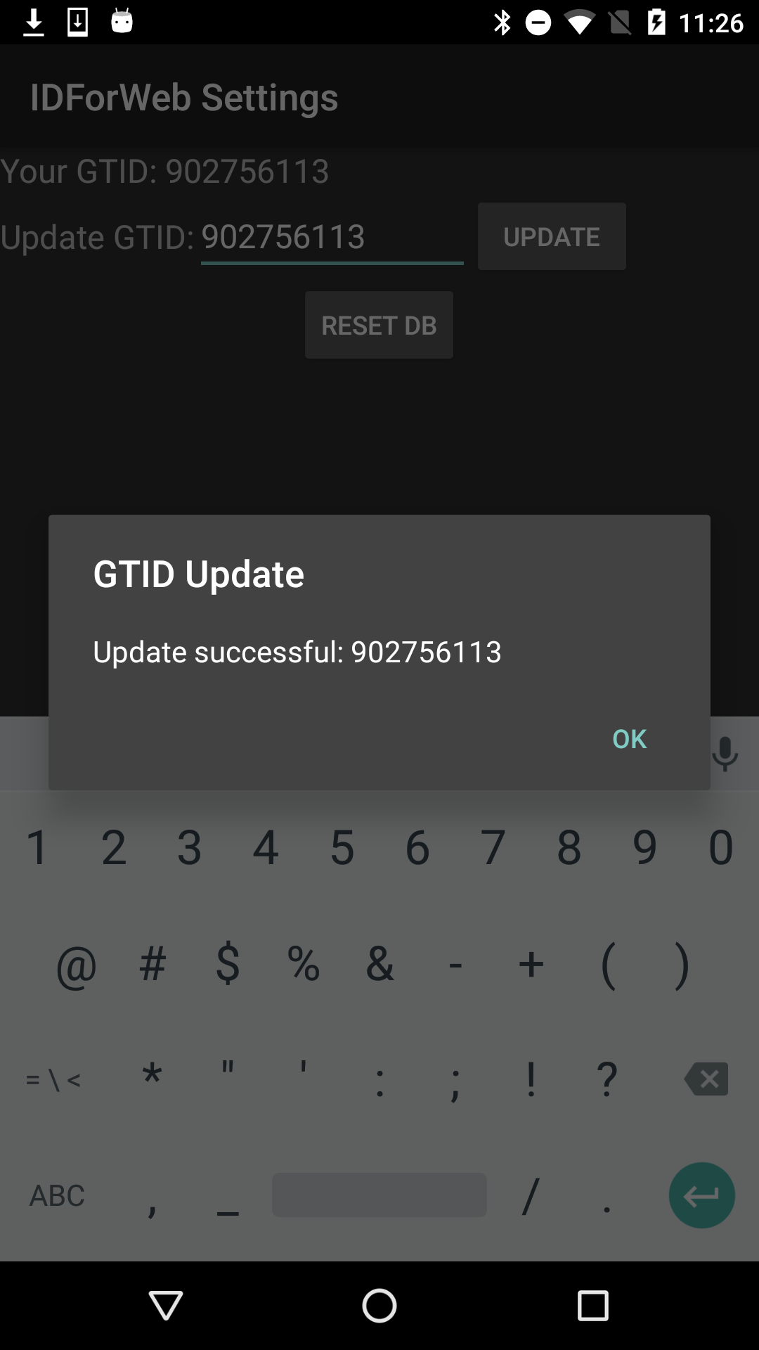
Testing Setup (One-time)
Run the application
Go to setting, type your GTID and click ‘UPDATE’
Check your GTID is displayed on top.
Click ‘Back’ to proceed to test.

Slide 7
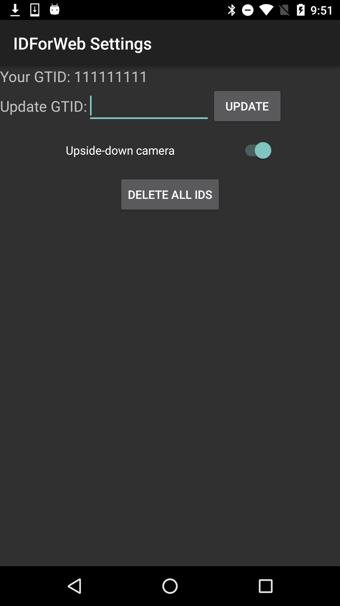
Testing Setup (One-time)
On recording, if your camera is upside down,
Then turn on ’Upside-down camera’ switch.
It will revert the image direction.

Slide 8
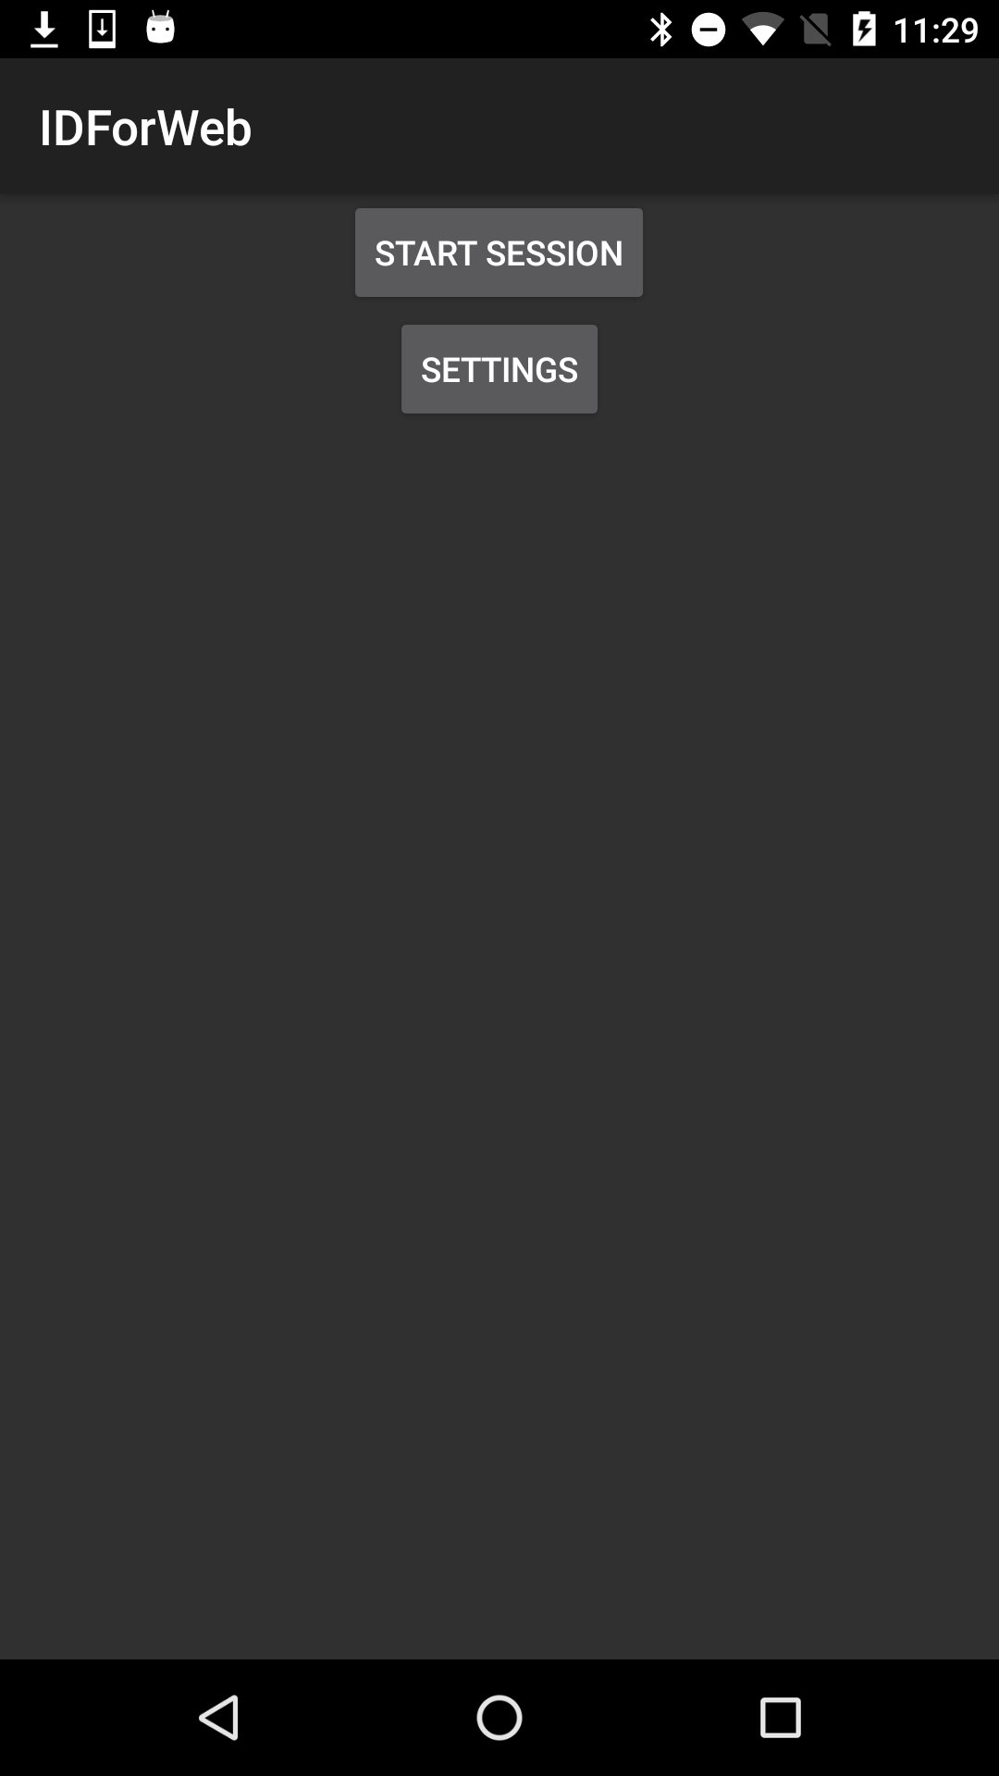
Front Menu
Two buttons,
Start Session
Starting of IDForWeb User testing session. It will show the consent form that participants are required to agree to participate to the user testing.
Settings
Go to the page that updates GTID

Slide 9
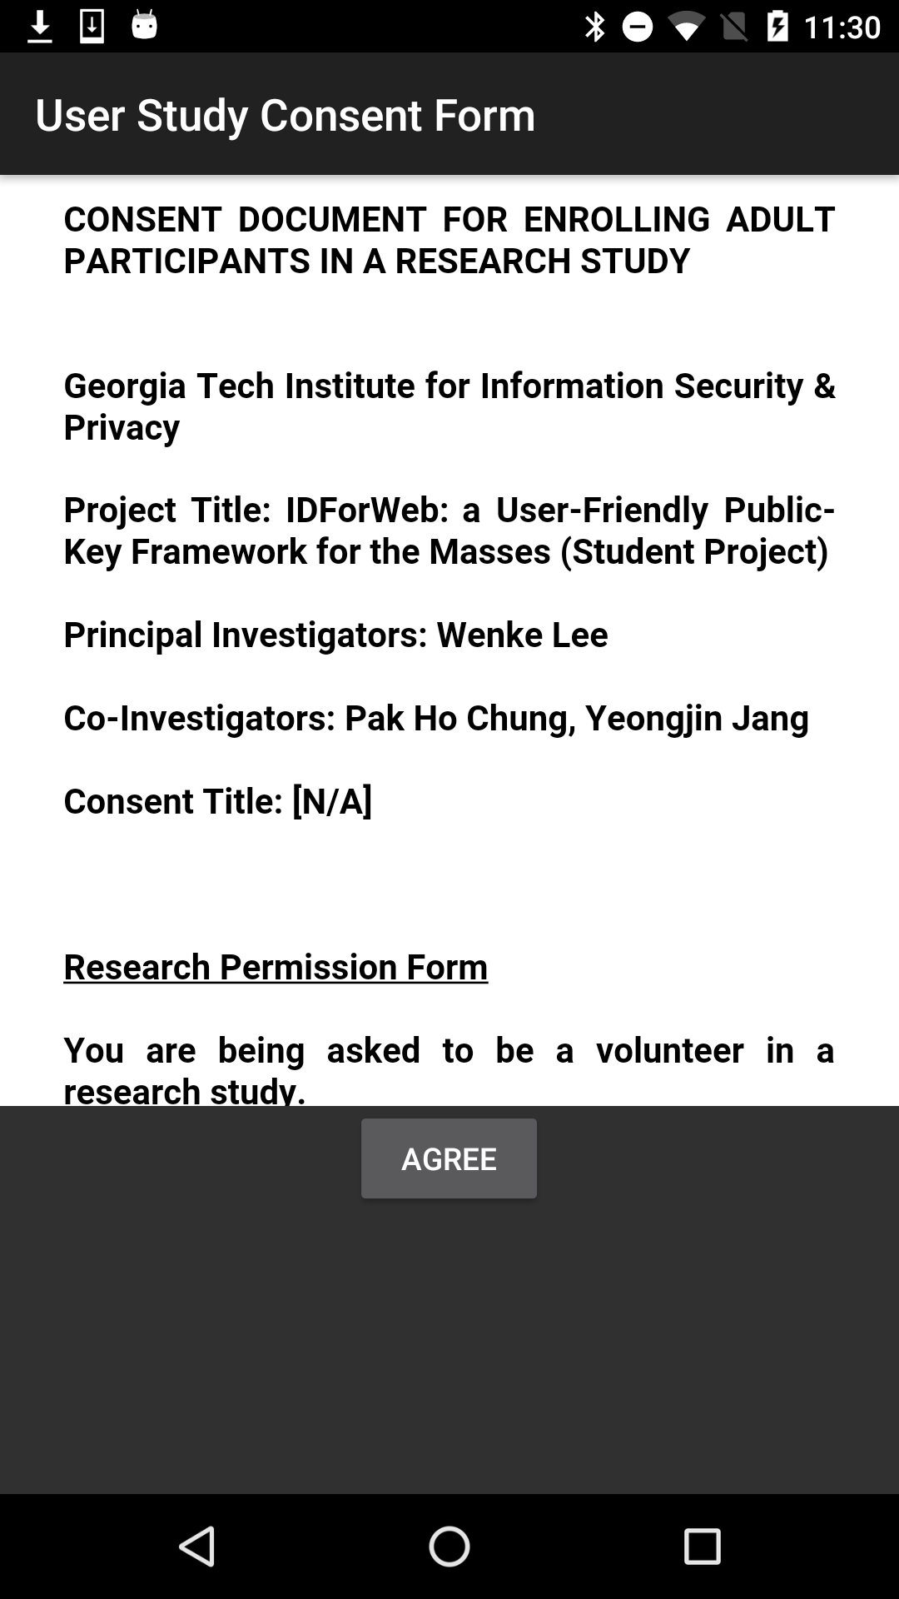
Consent Form
On clicking ‘Start Session’,
A consent form comes up.
Make sure the participants fully read and understand the contents, and proceed test if he/she voluntarily agreed with the consent form.
Click ‘Agree’ to agree with the form.

Slide 10
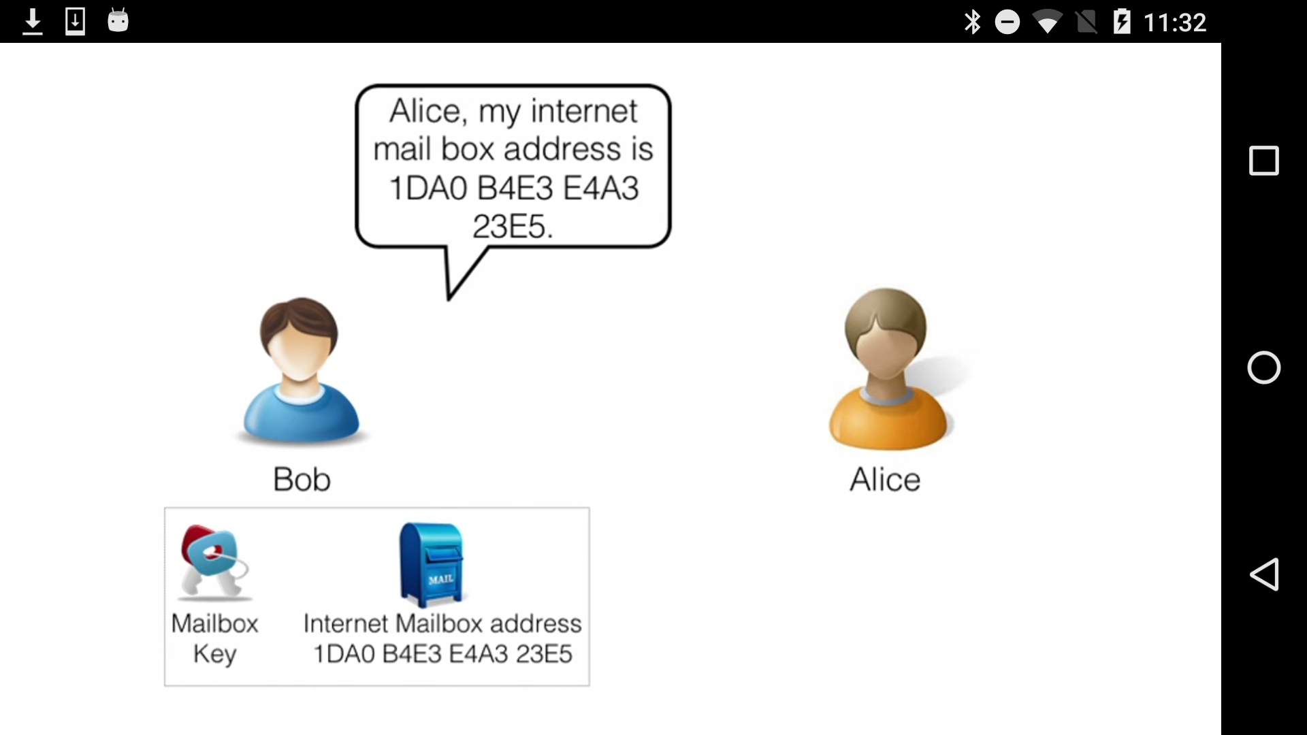
Introductory Video
A 6 minute video that introduces IDForWeb will be played. Please let participants watch the video, to have knowledge what IDForWeb is, and which kind of problem it tackles.
After the video is finished, the screen will automatically move to the menu.
If not, please press back button.

Slide 11
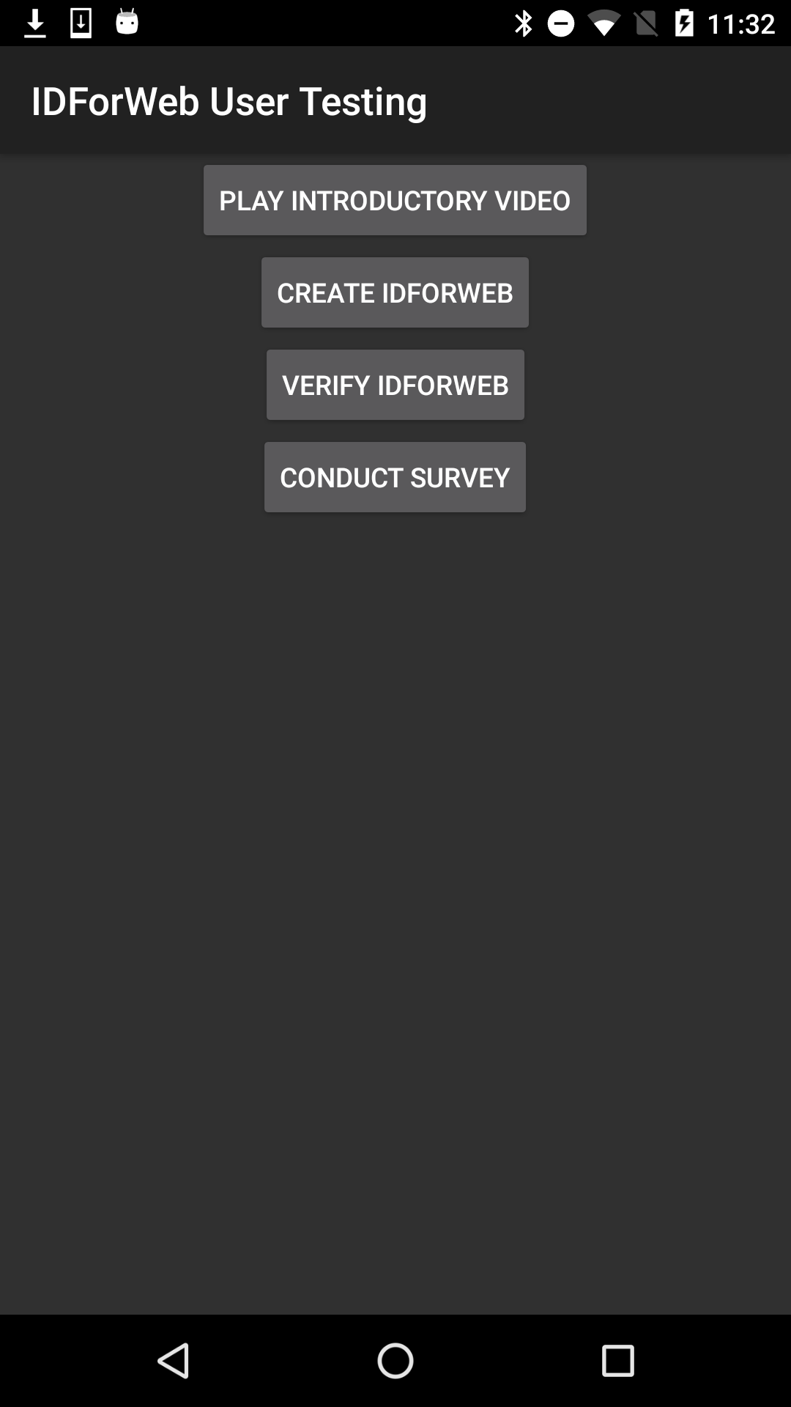
Testing Menu
4 Buttons
Introductory Video
Click to watch the introductory video again
Create IDForWeb
Click to create IDForWeb, the Task 1 for the participants
Verify IDForWeb
Click to verify IDForWeb, the Task 2 for the participants
Conduct Survey
Click to conduct survey, the final task for the participants

Slide 12
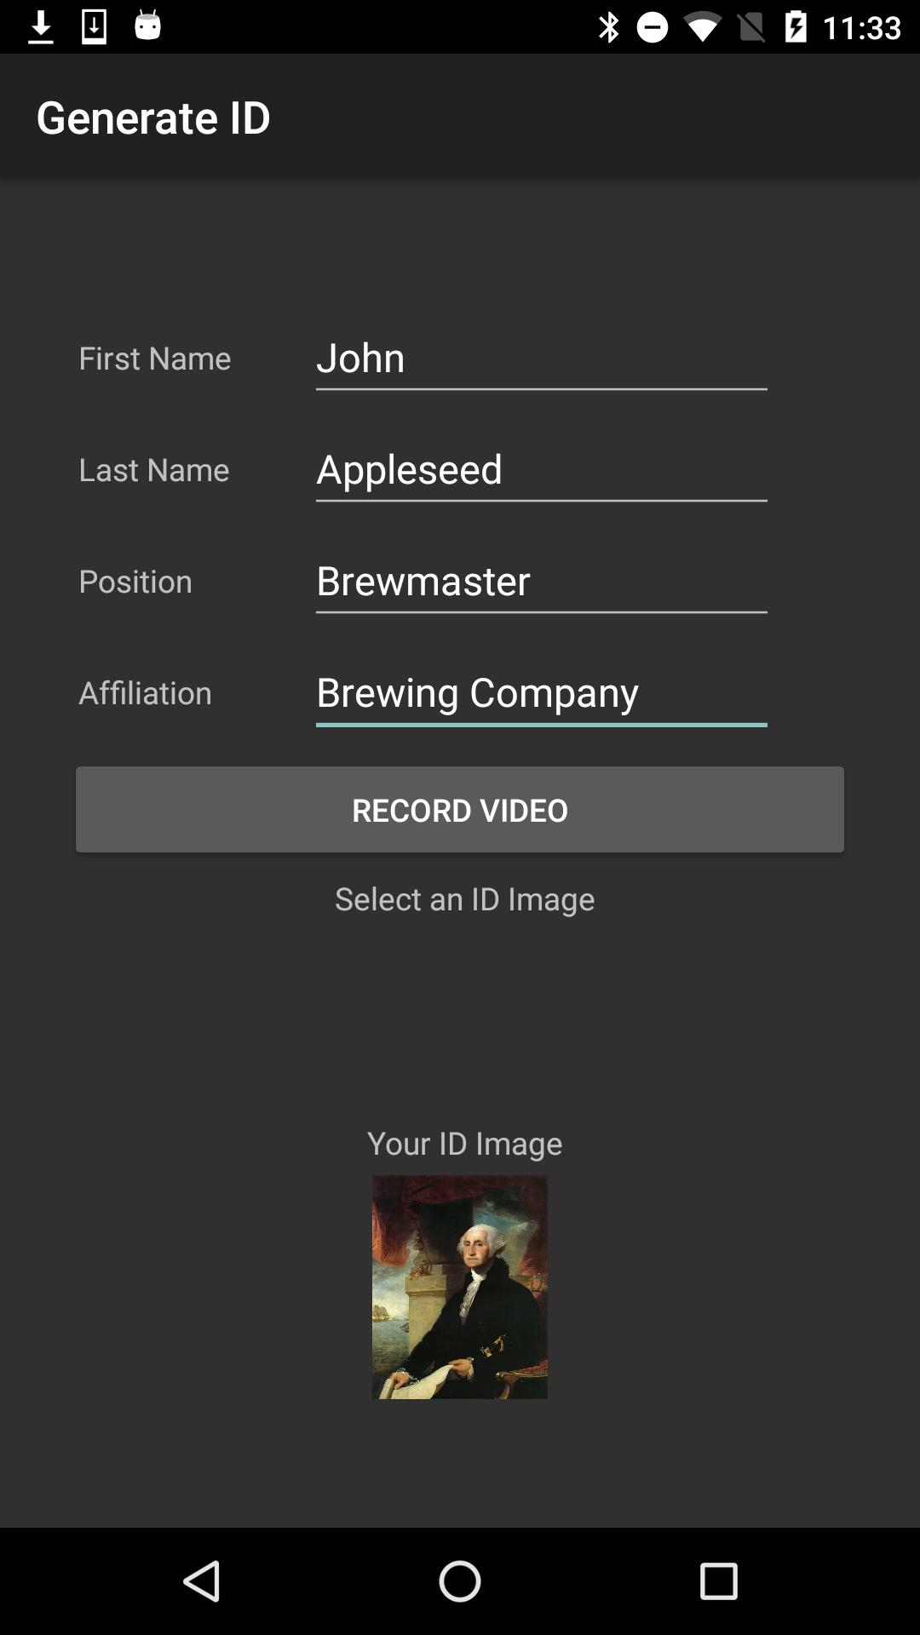
Create IDForWeb (Task 1)
To create IDForWeb,
1. Type user information on the form, such as
First name
Last name
Position (in affiliation)
Affiliation
2. Then, click Record Video

Slide 13
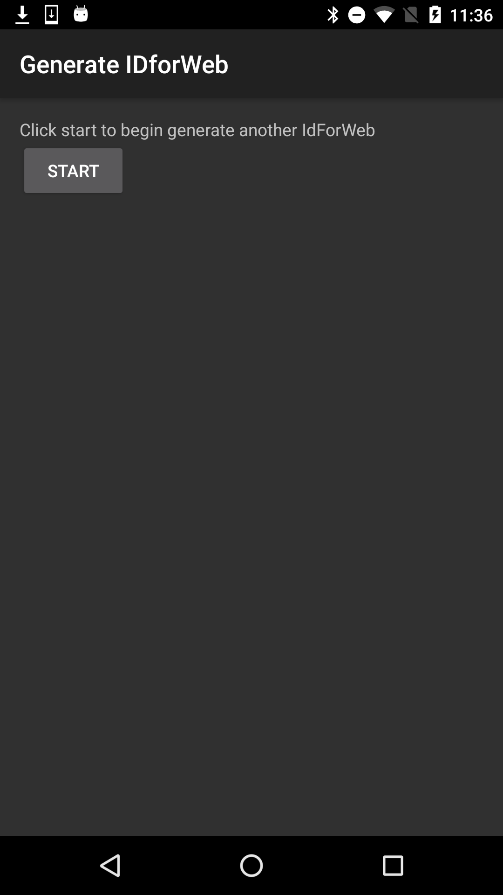
Create IDForWeb (Task 1)
Recording Selfie Video
A. Wait until the app is being initialized
B. Click ‘Start’ to begin recording

Slide 14
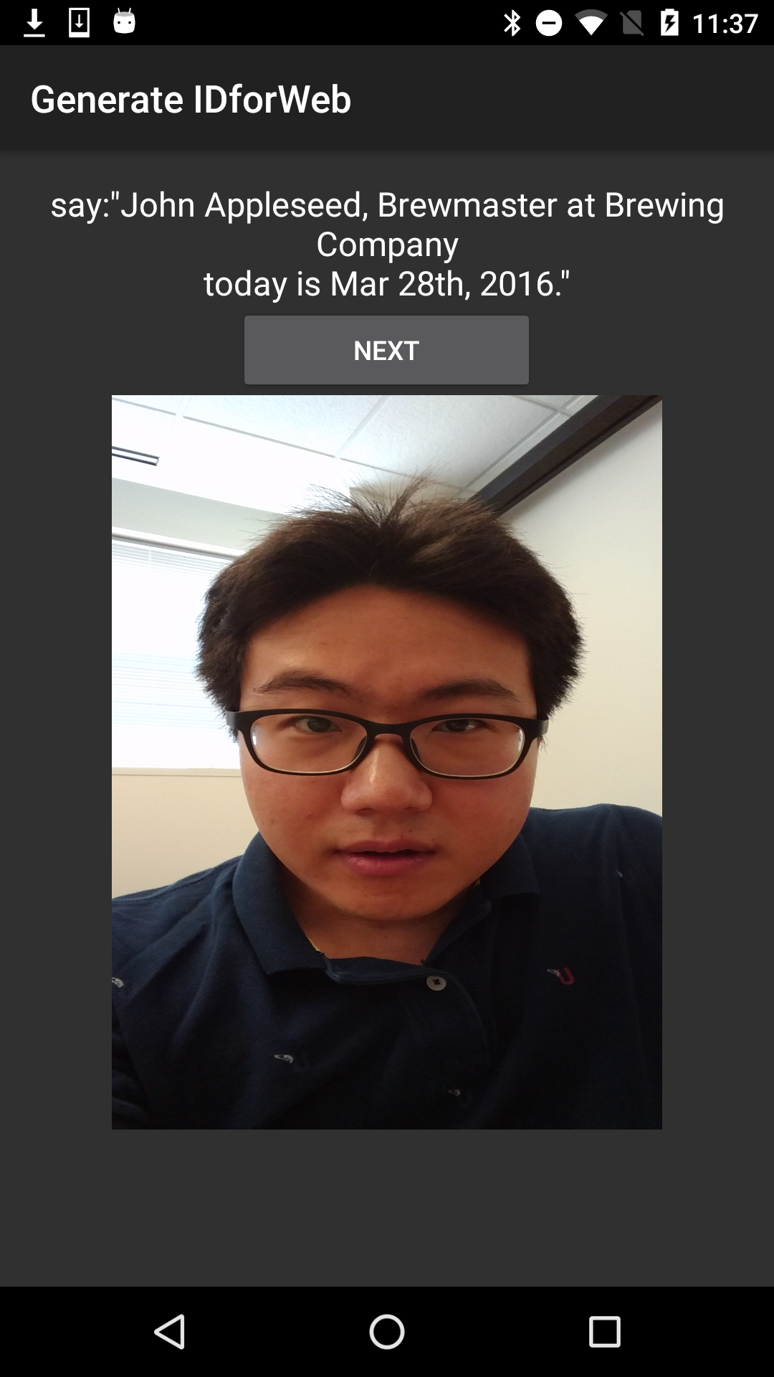
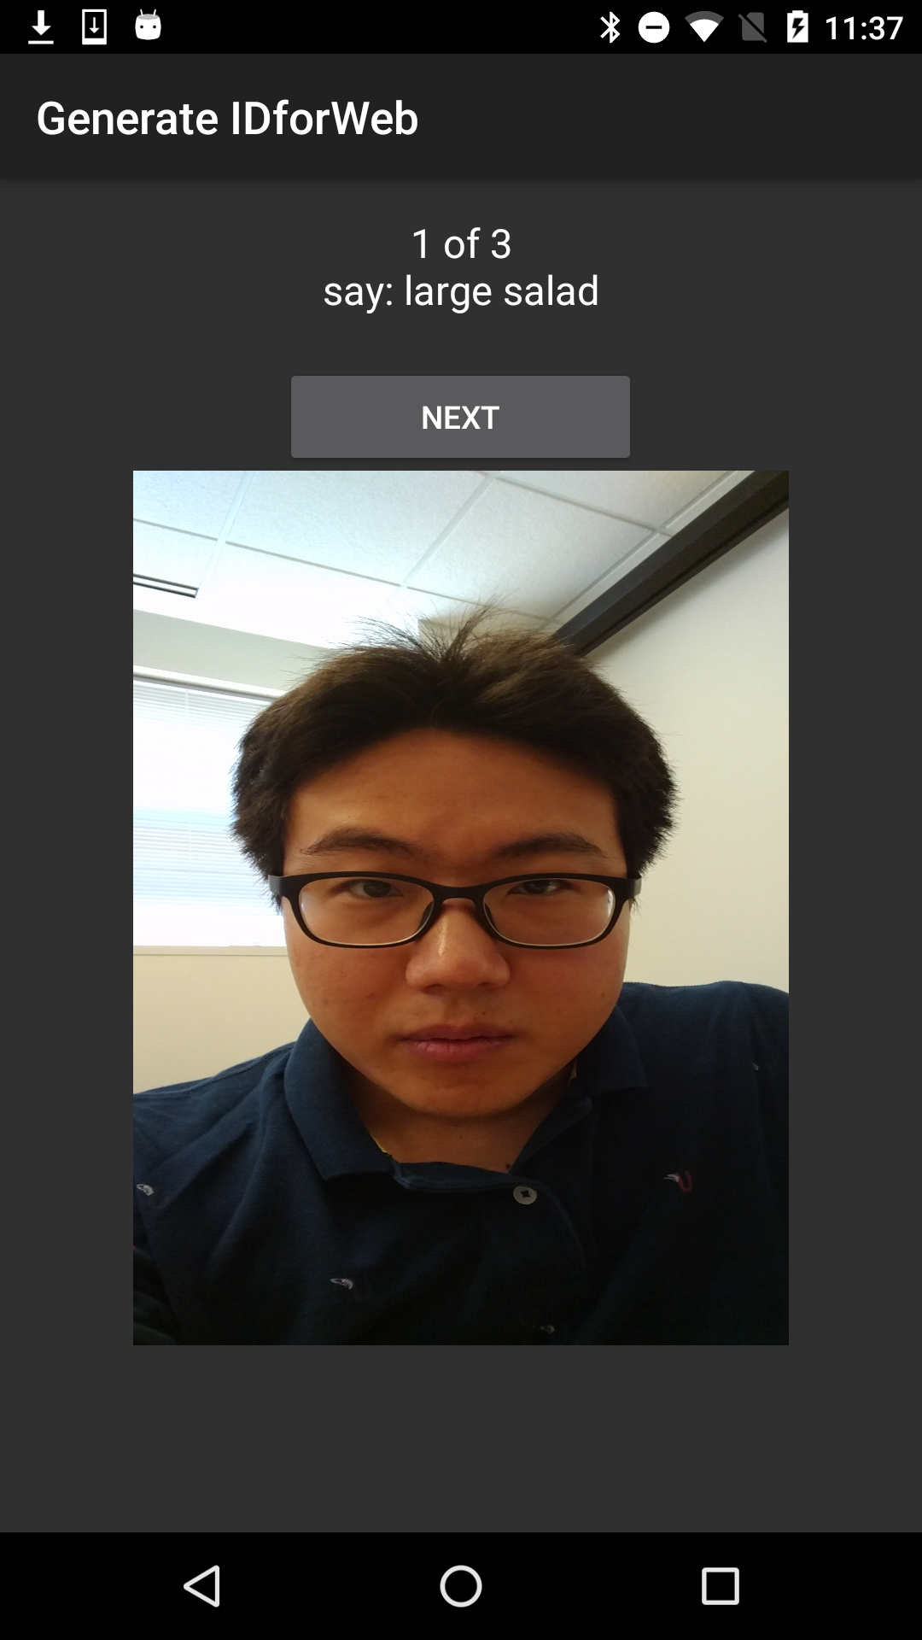
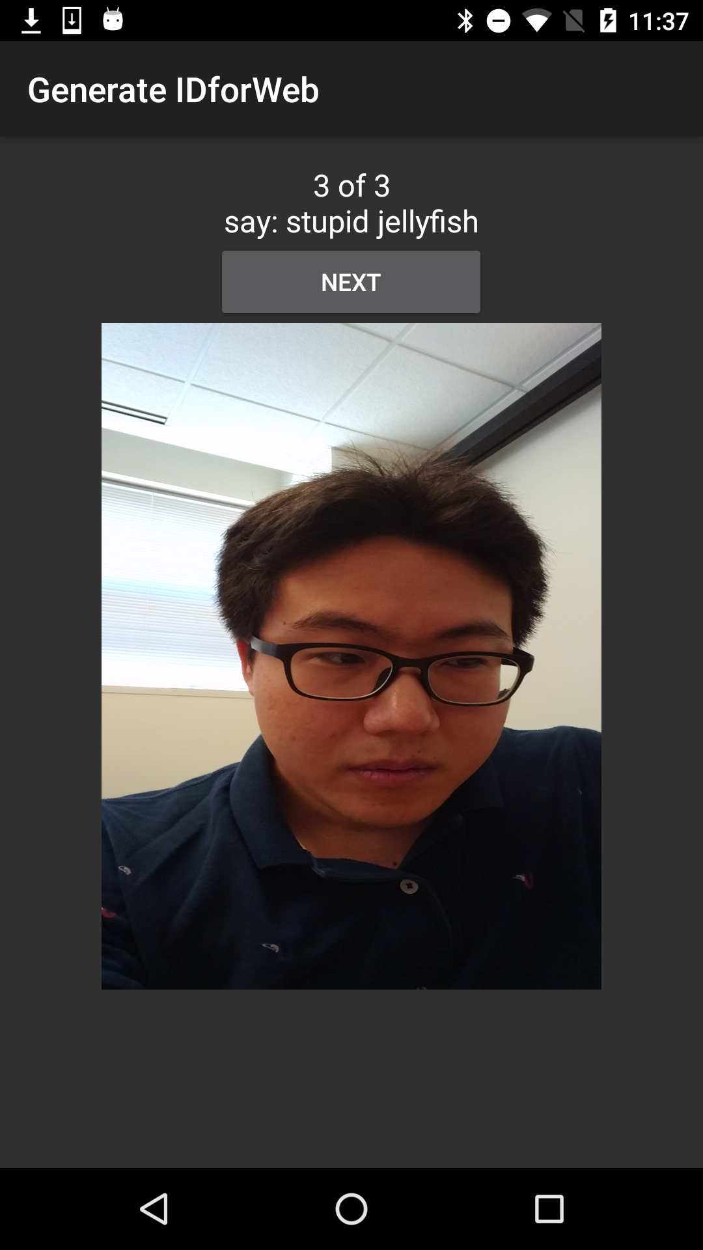
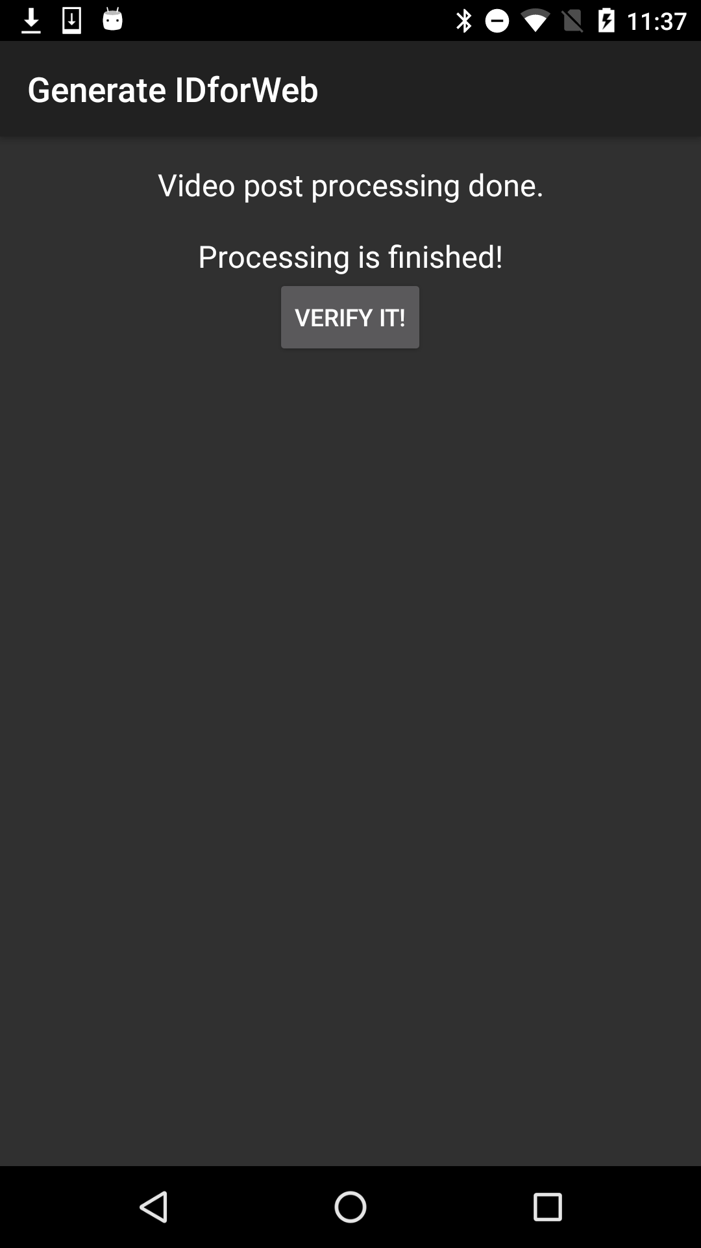
Create IDForWeb (Task 1)
Recording Selfie Video
B. When Phrase comes in, read the phrase,
C. Click ’Next’ if speaking of each phrase is finished.
D. At the end, click ‘Verify It’ if you finished with all phrases.

Slide 15
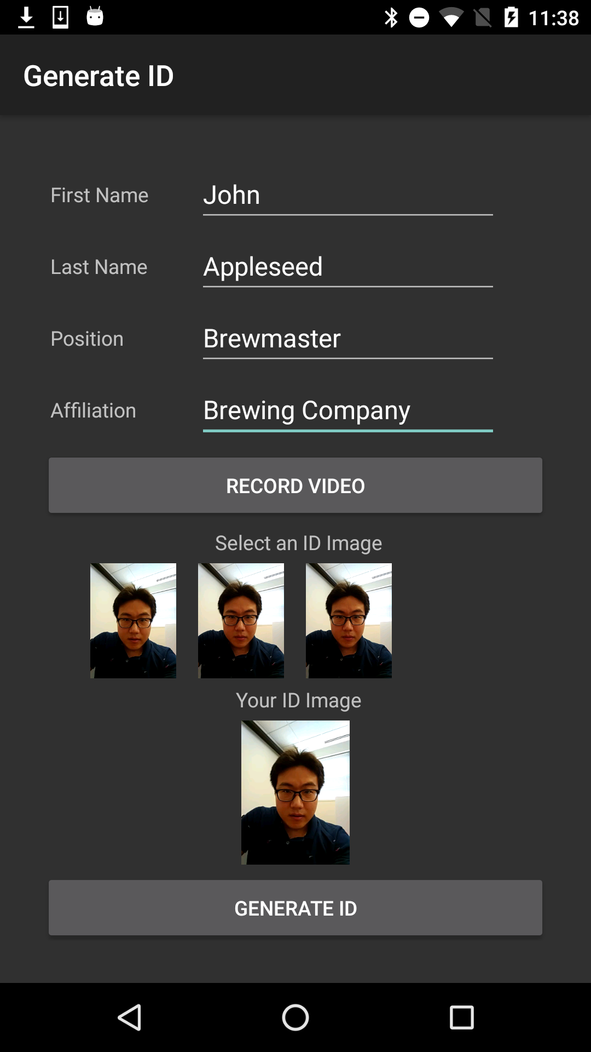
Create IDForWeb (Task 1)
Now, the snapshot of videos will be shown on the bottom.
Click on the one of the picture that will be used as a main photo for the ID.
Preview will be shown on the bottom.
Then, click ‘Generate ID’ to create IDForWeb

Slide 16
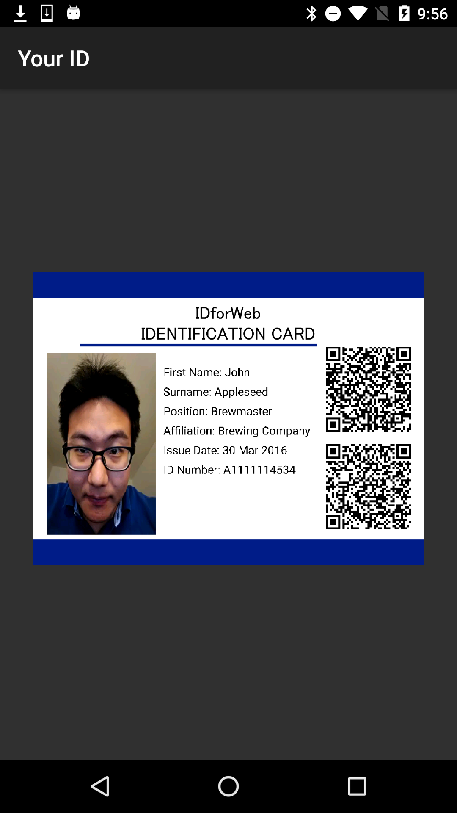
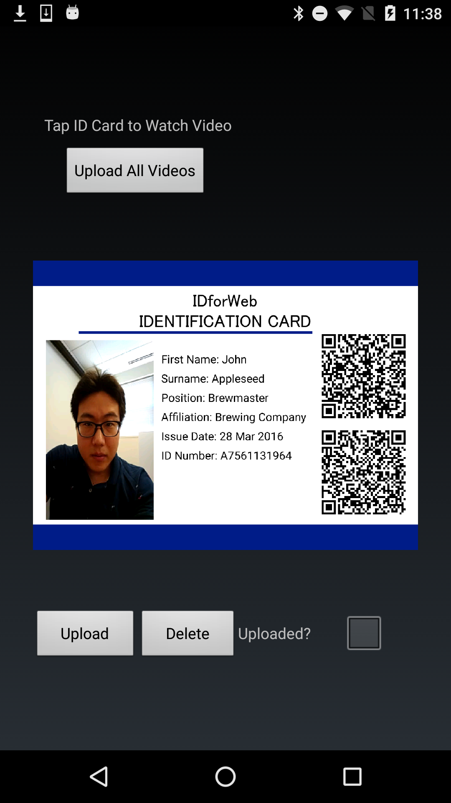
Veryfy IDForWeb (Task 2)
Click on the ID (Picture) that you want to run Verify

Slide 17
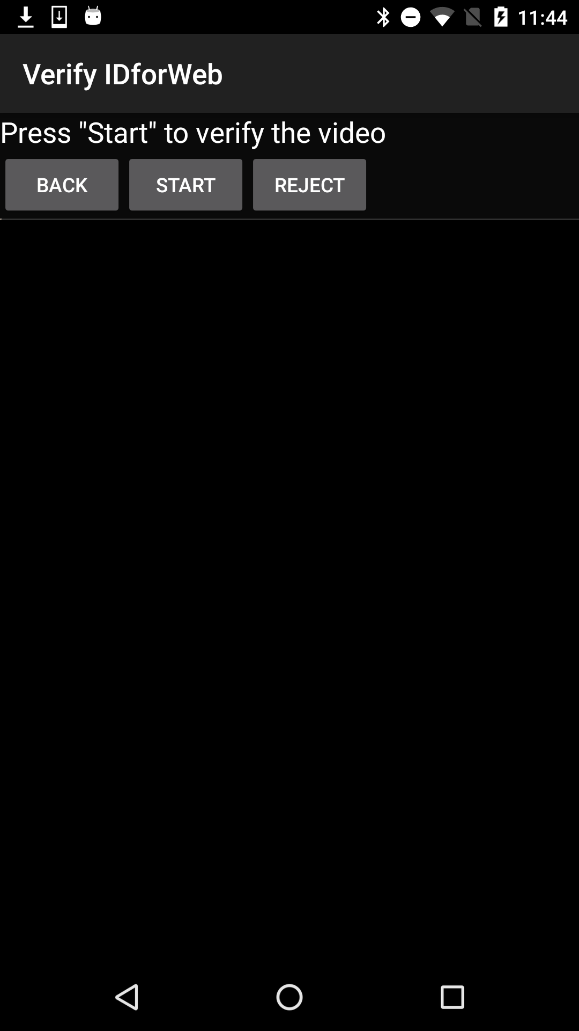
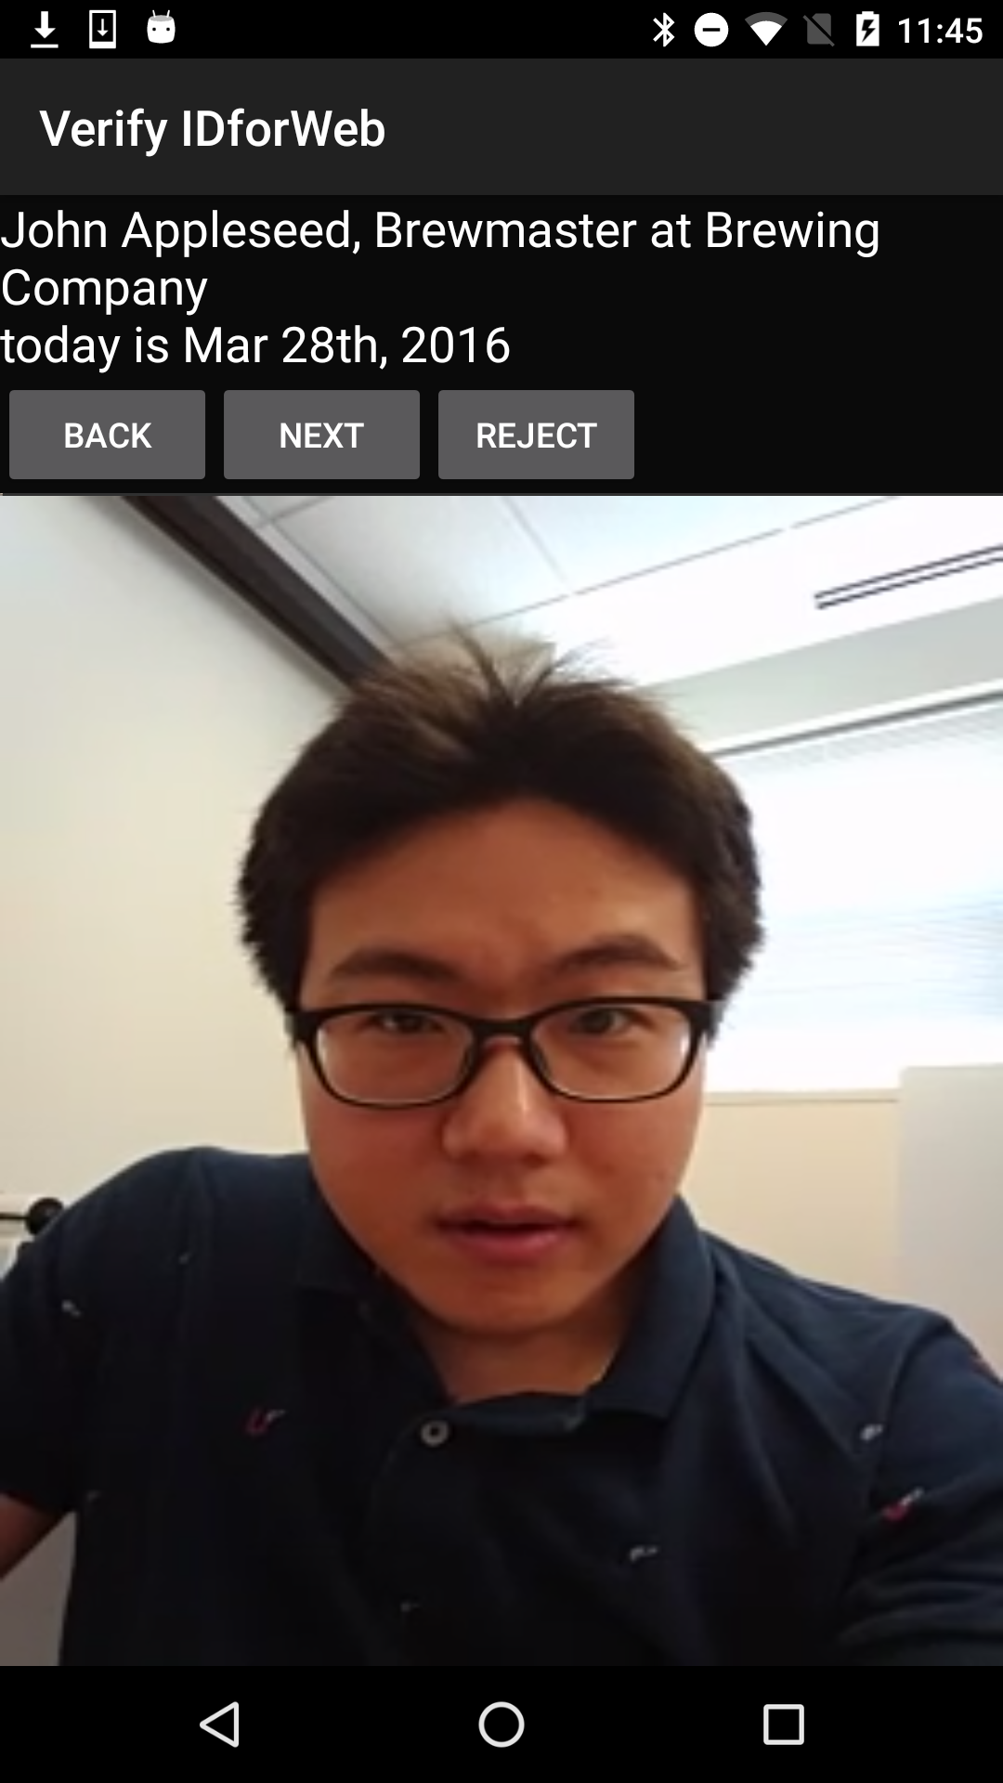
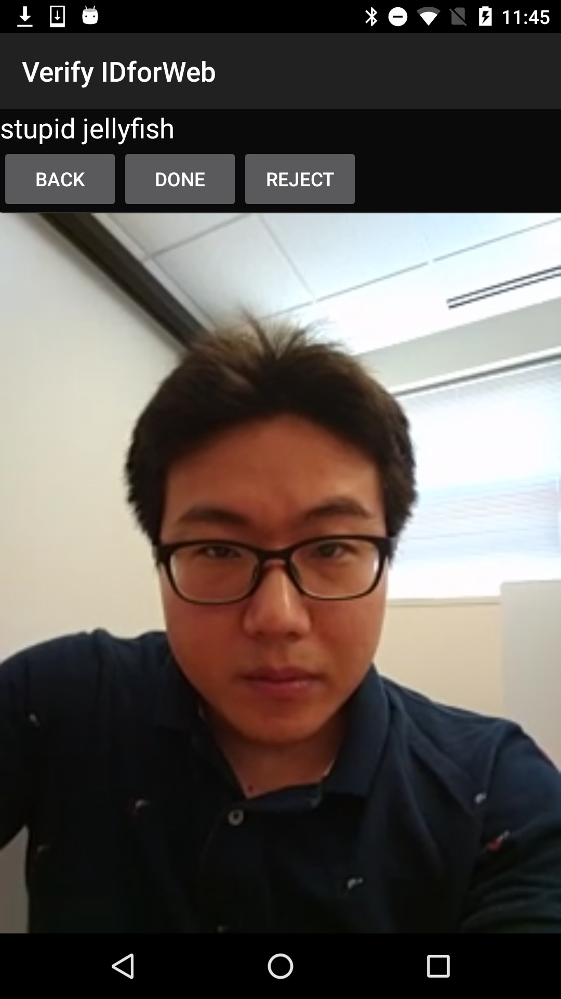
Veryfy IDForWeb (Task 2)
Click ‘Start’ to start verifying session.
Click ‘Reject’ if any of phrase was wrong.
Click ‘Done’ if all phrases are spoken correctly.

Slide 18
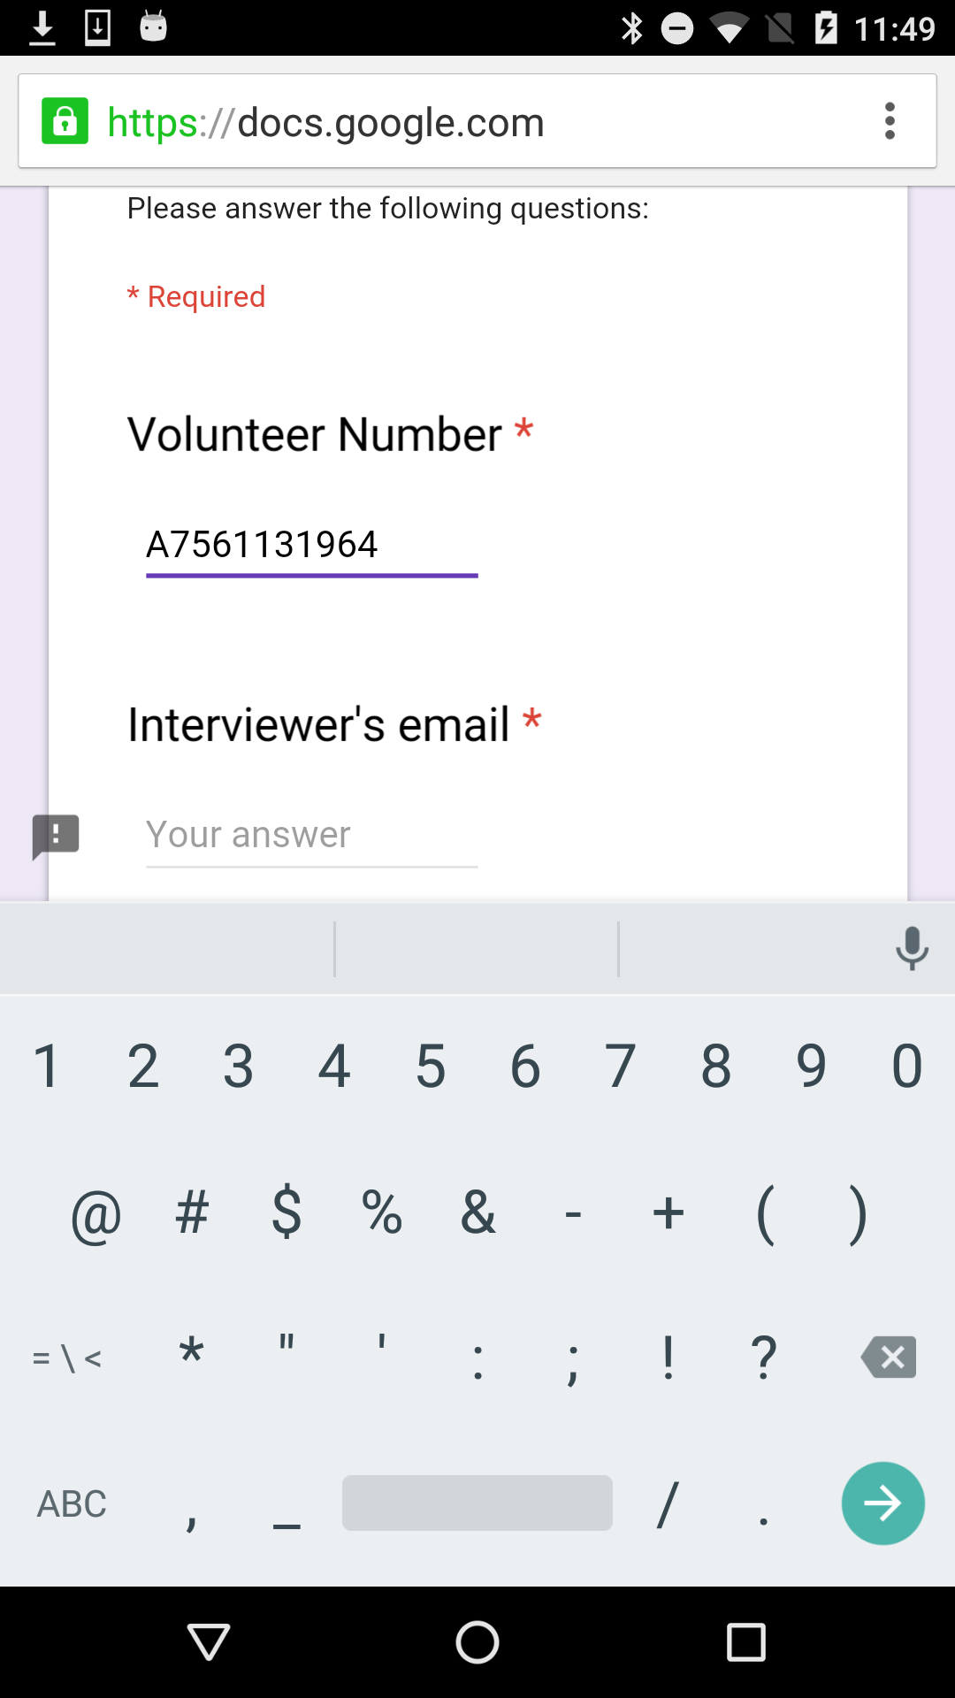
Conduct Survey
After Task 1 and 2 are finished, let participants conduct survey.
It is required to sign-in to Google because it is a Google Form, so please let participant do so.
Type volunteer Number as
Number in created ID..

Slide 19

Uploading of the ID
To grade your testing assignment, we collect generated ID into our server.
Note that we encrypt, and having strong access control on the server-side
The ID will not be accessed by public.
Please click ‘Upload’ button on verify menu (or click upload-all)
Note that each video contains around 2MB, so please try upload when you are connected with Wi-Fi.
After upload is finished, a check-mark will be displayed.

Slide 20
Caveat
If the app is not responding, or having dialog like ‘The App IDForWeb is stopped’,
Then open task manager, try to kill the all apps, and try again.
If you cannot get the recording correctly for multiple runs, then your device is not yet supported by the prototype version of IDForWeb. In such case, use the web-app.
https://idforweb.github.io

Slide 21
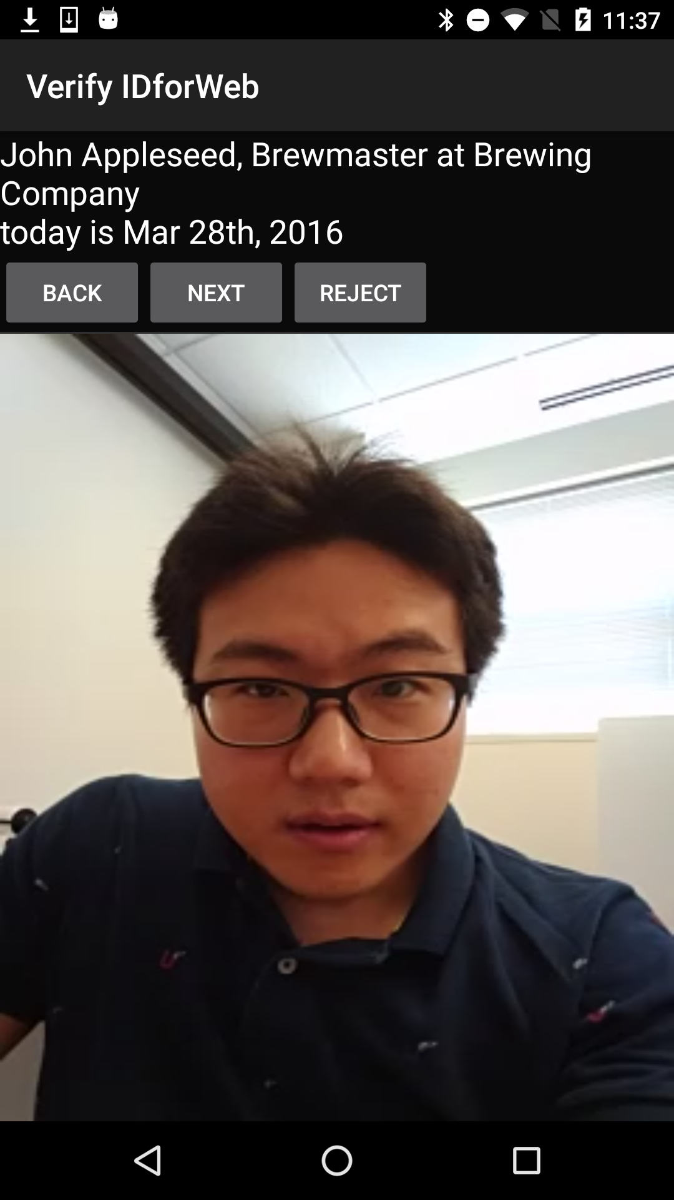
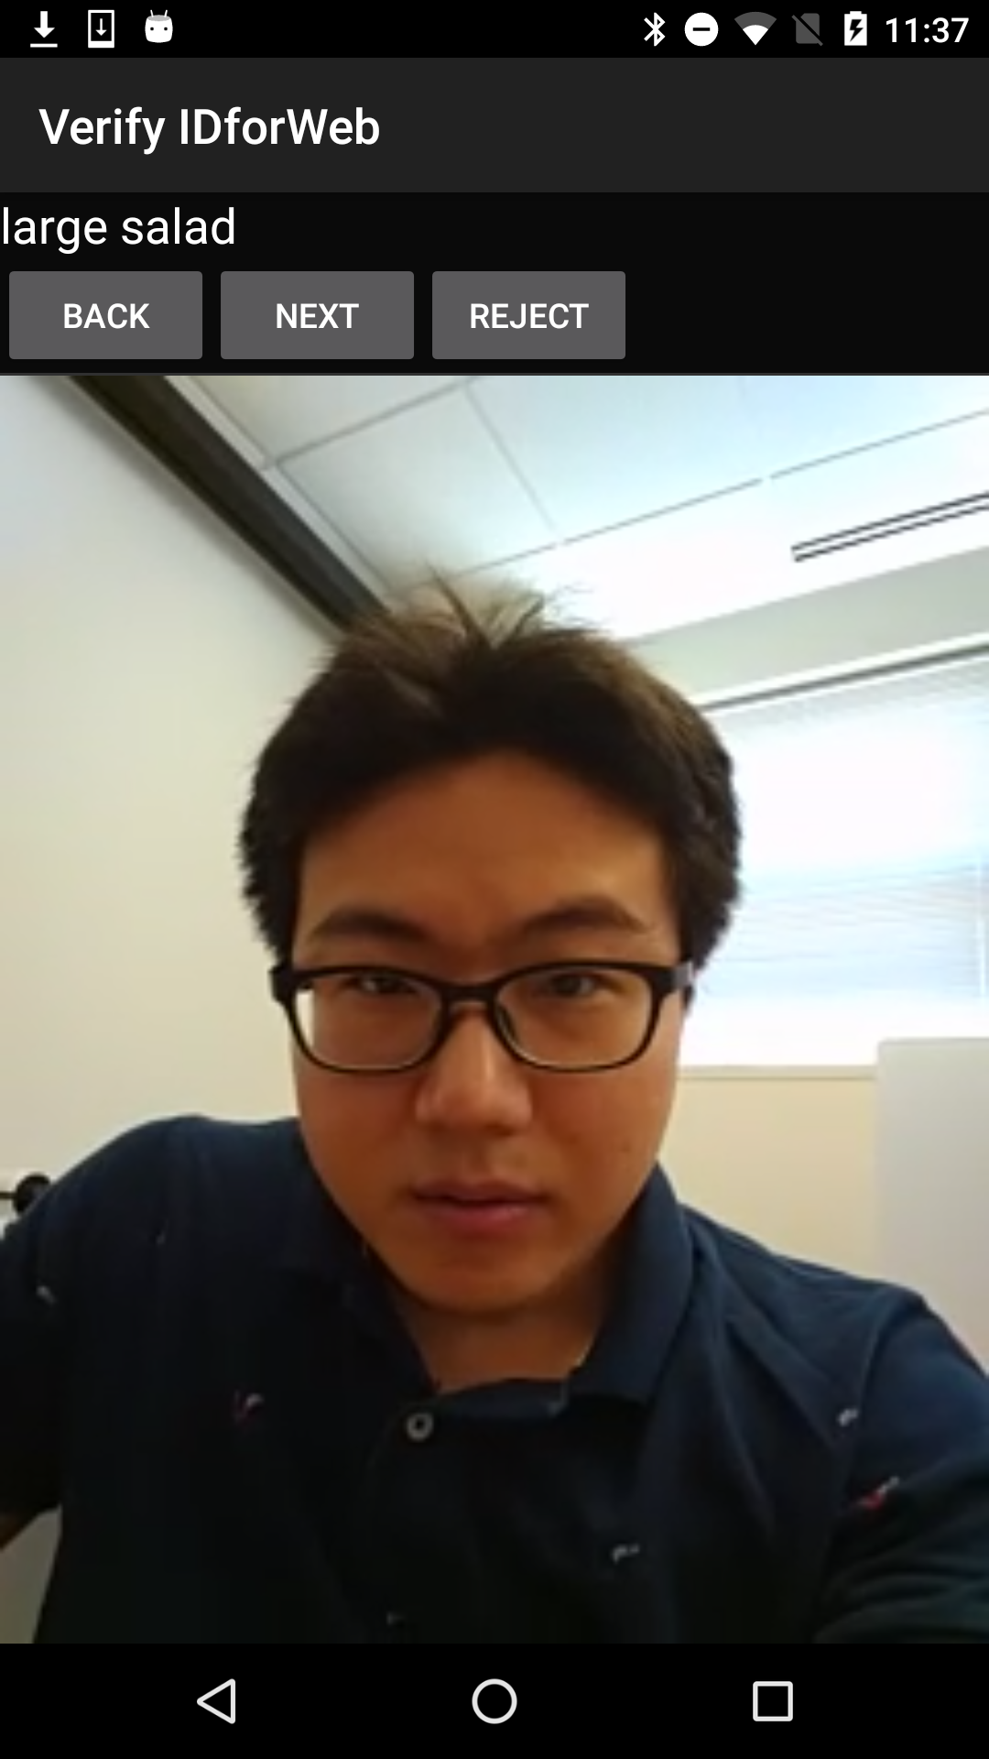
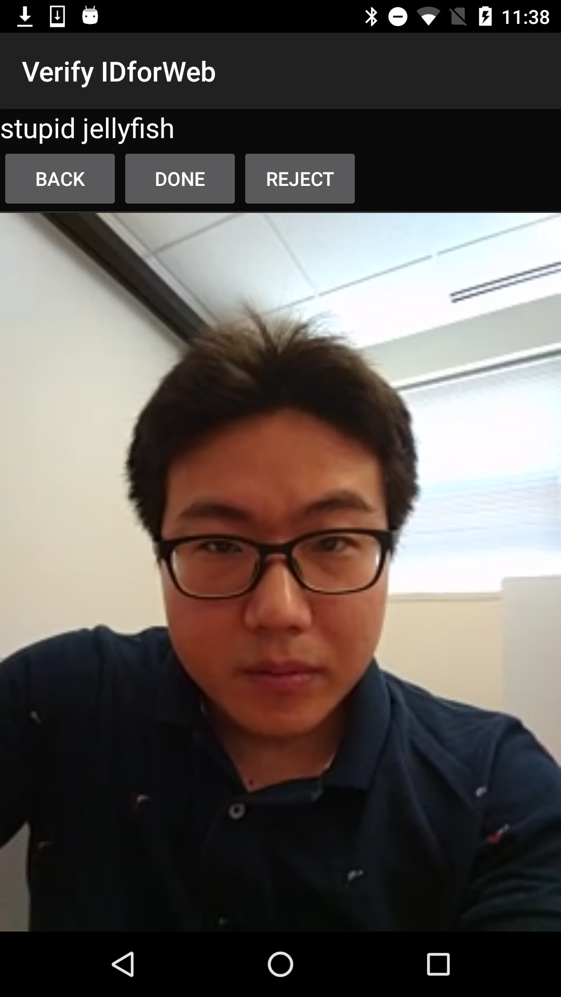
Create IDForWeb (Task 1)
Verifying by themselves
Next, let the participants verify the video by themselves
Note that the video will be used for the other person to verify the participants.
Click ‘Start’ to start verify step.
Phrases will move, and if the speech is not matched with the phrase, click ‘Reject’
This will let the participants do recording again.
If all phrases looks correct, click ‘Done’

